Slide 1
Exploratory functions and features

Slide 2
Demo data
CentralParkTemps.txt
CO2perCapita.csv

Slide 3
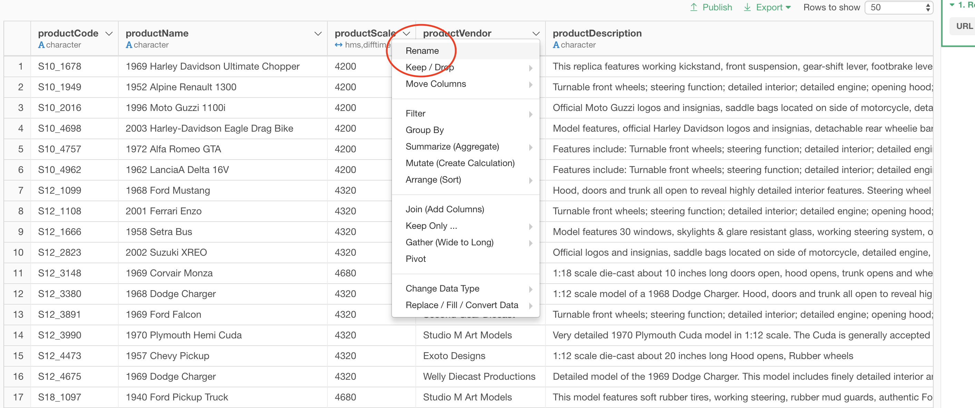
Renaming columns

Slide 4
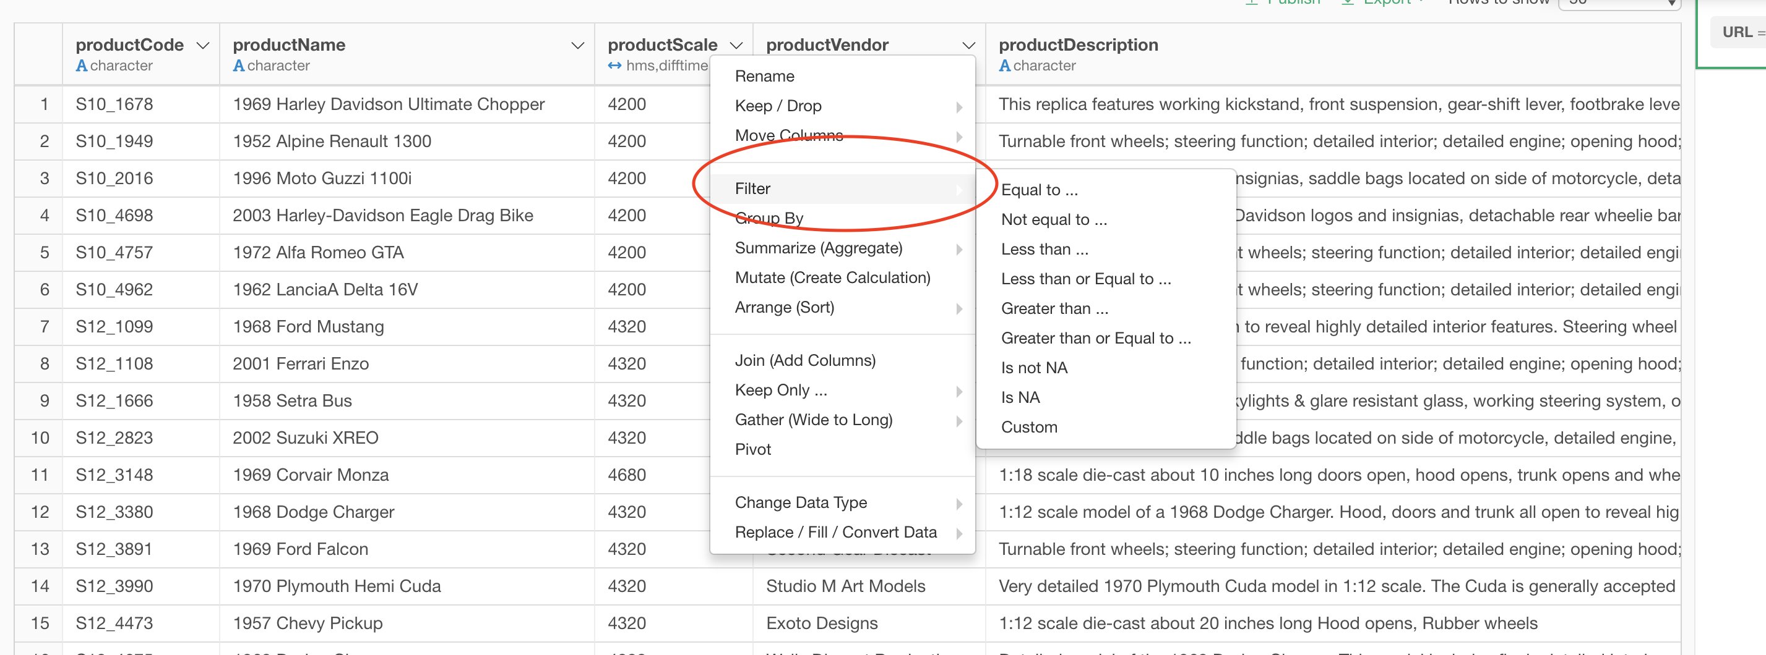
Filtering data in columns

Slide 5
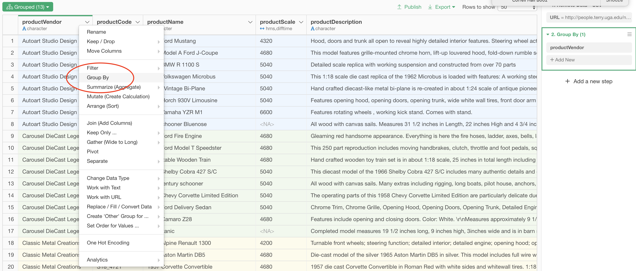
Group By columns (use carefully)

Slide 6
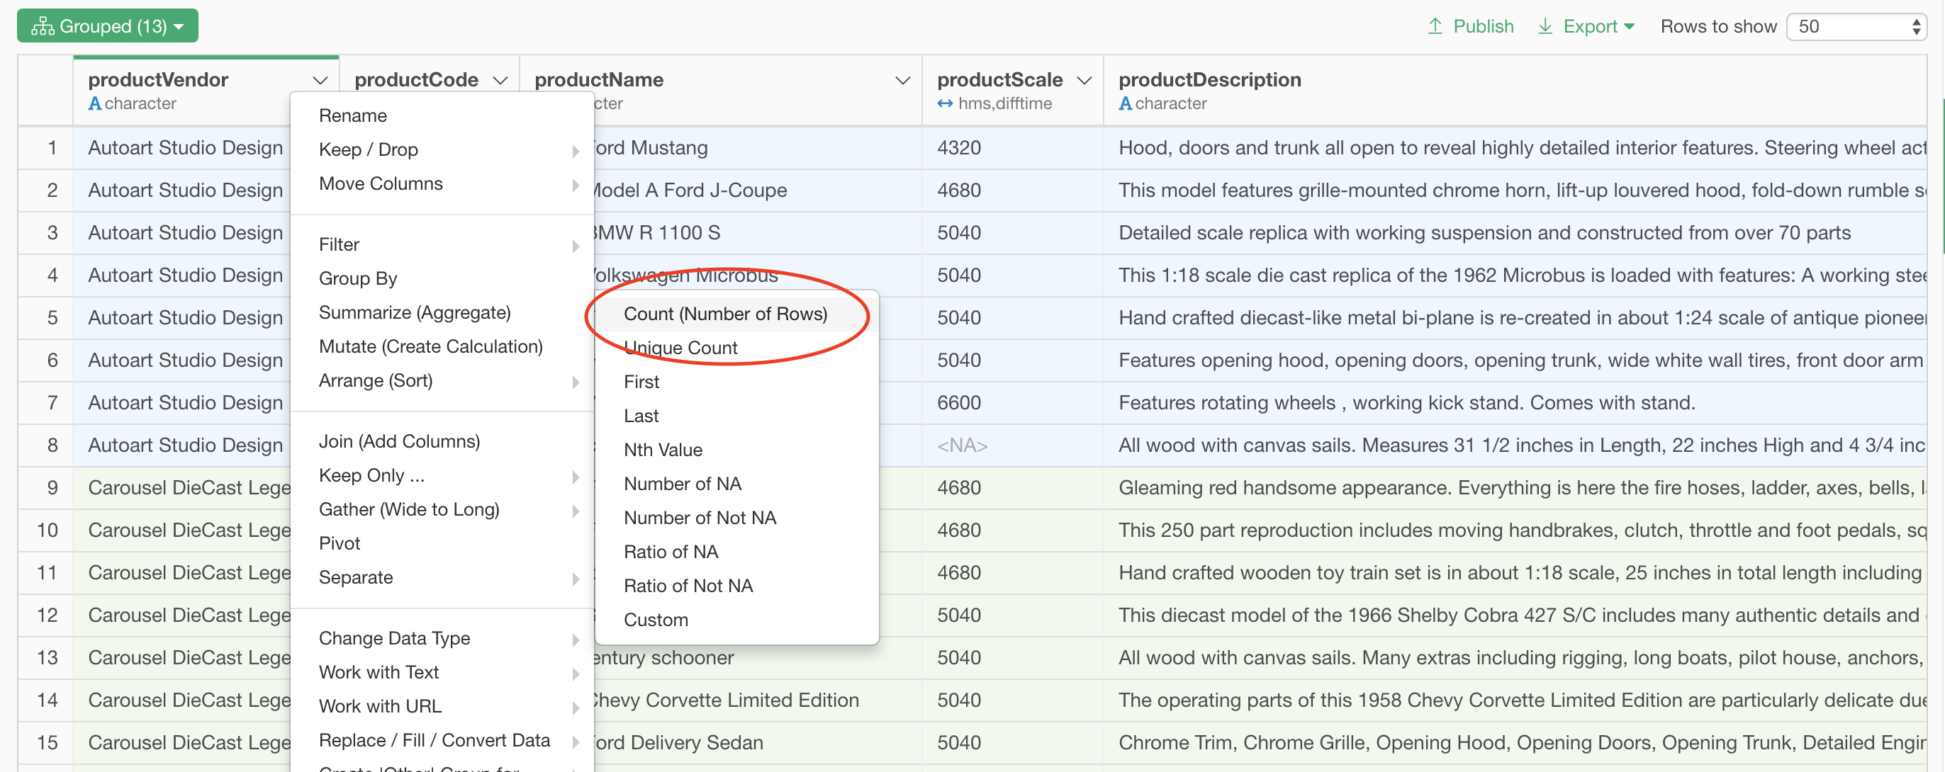
Summarize data (functions vary based on column type)

Slide 7
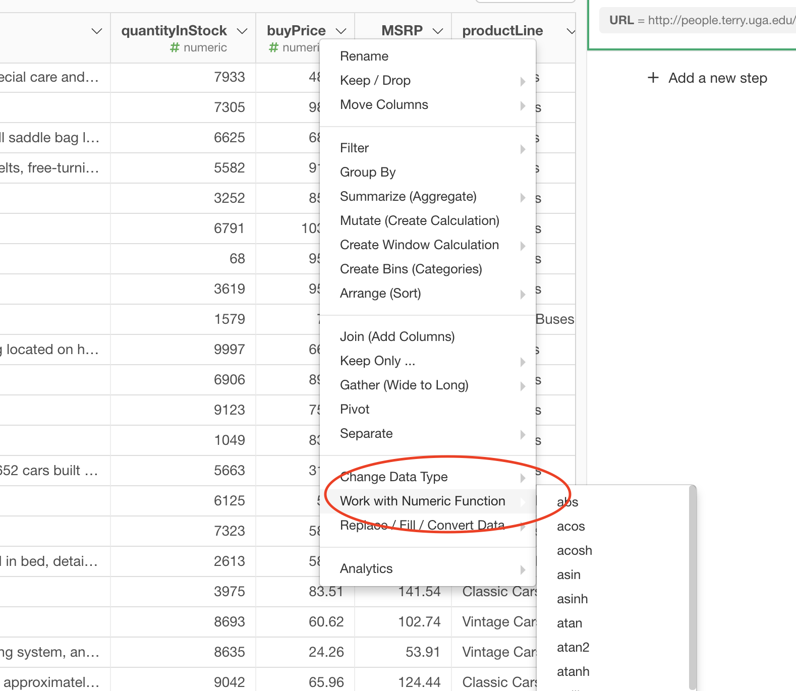
Functions based on column type

Slide 8
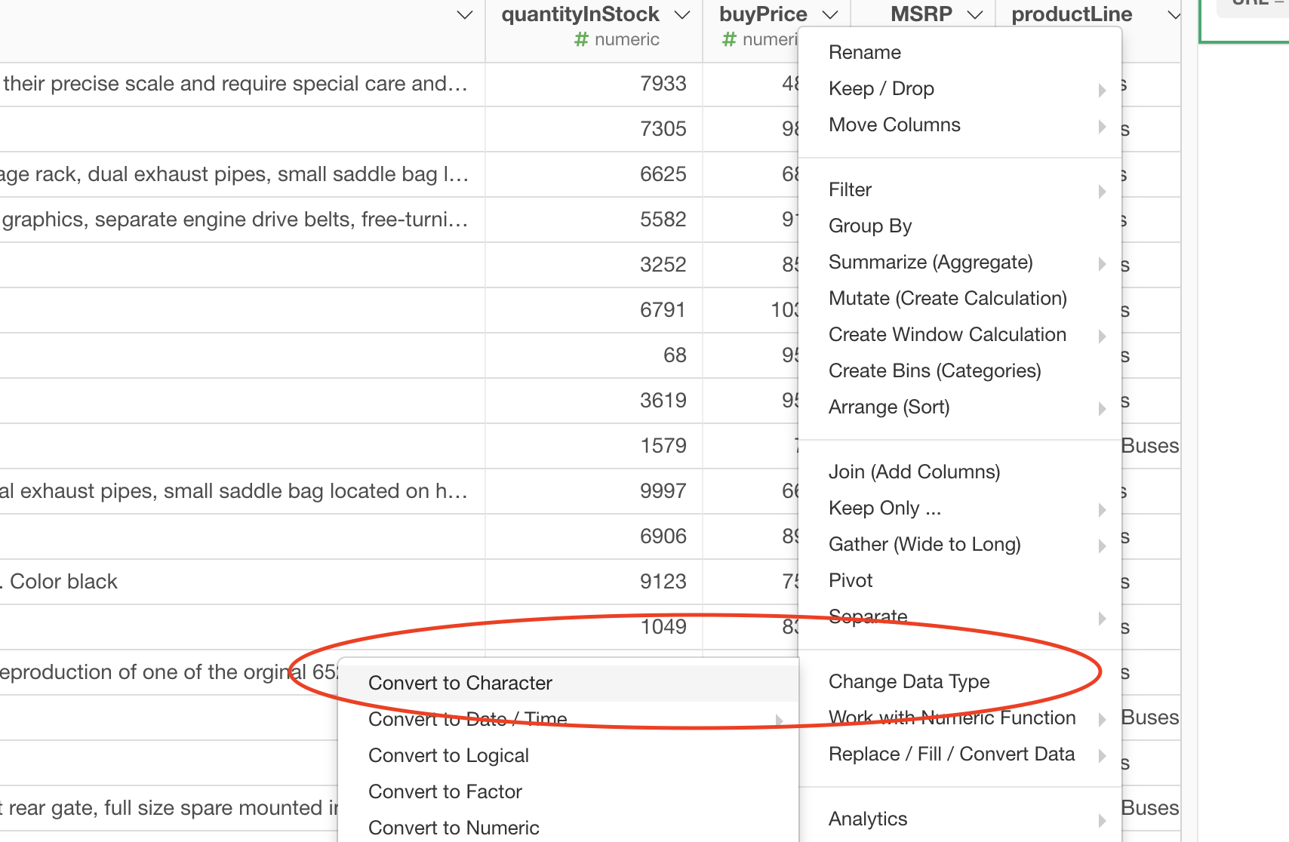
Change column data type

Slide 9
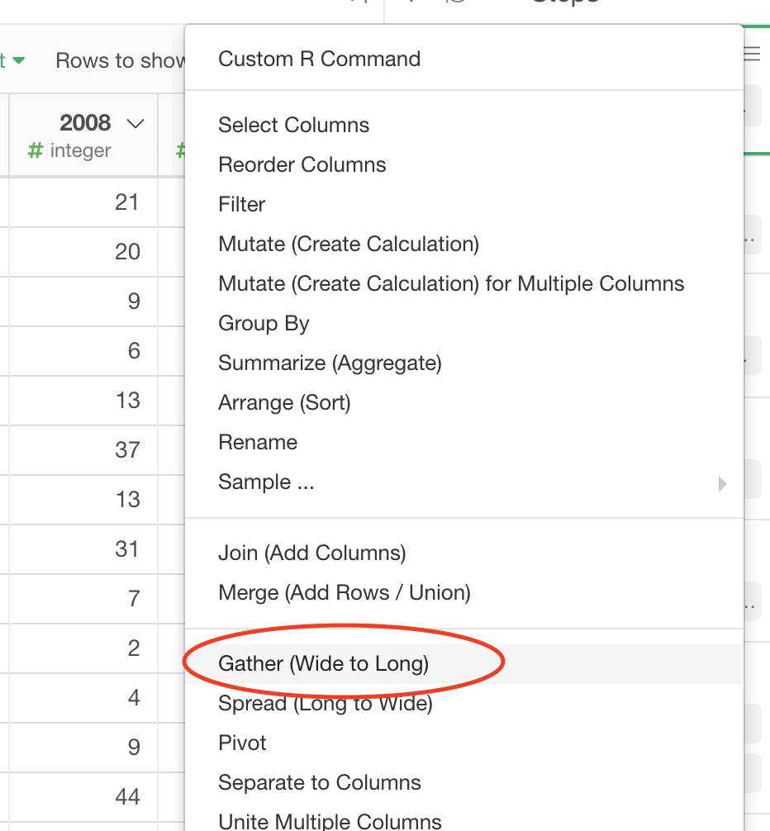
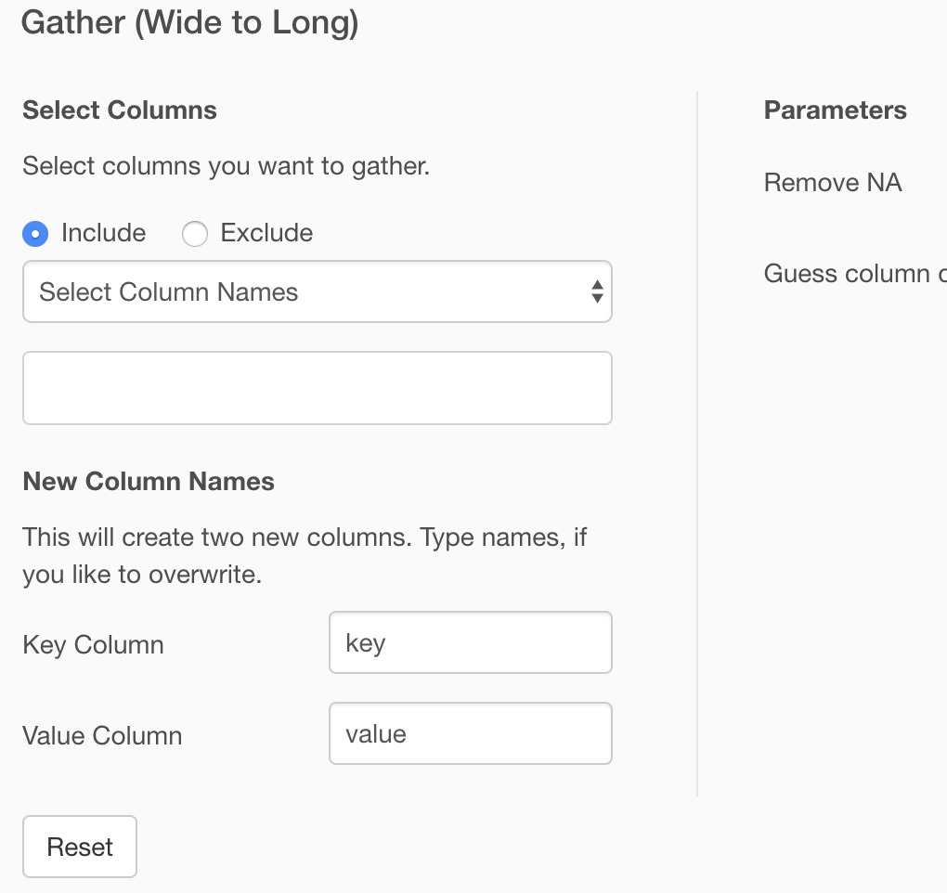
Gather (wide to long form data)

Slide 10
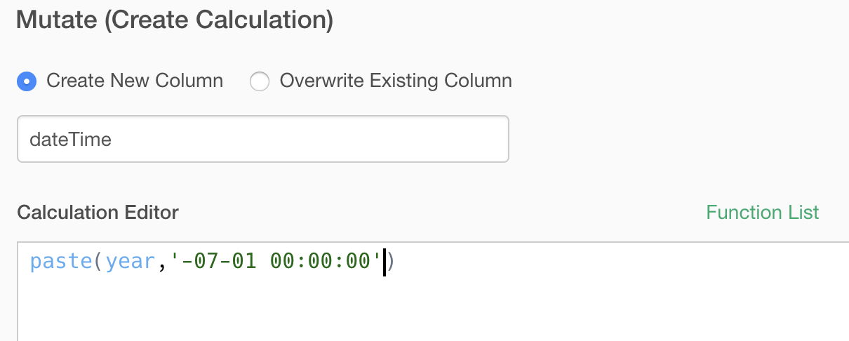
Paste (concatenate values)

Slide 11
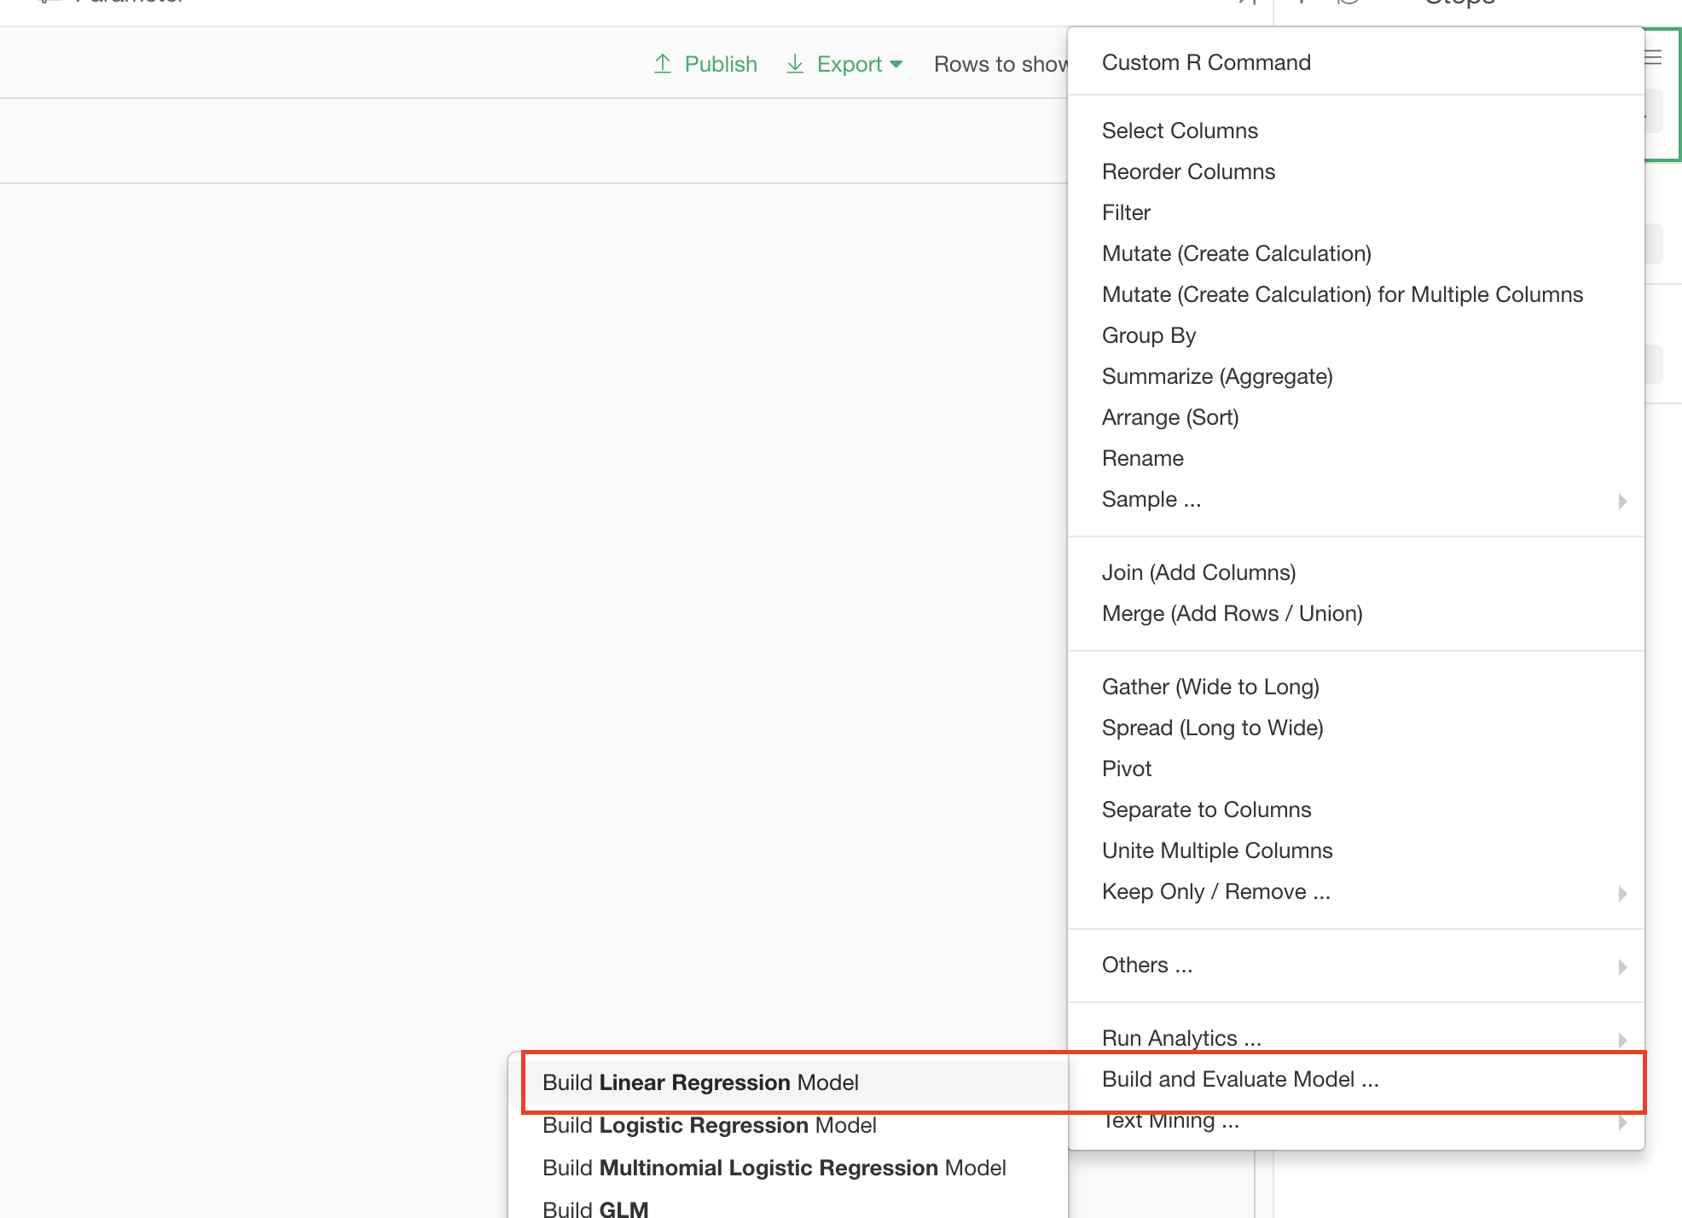
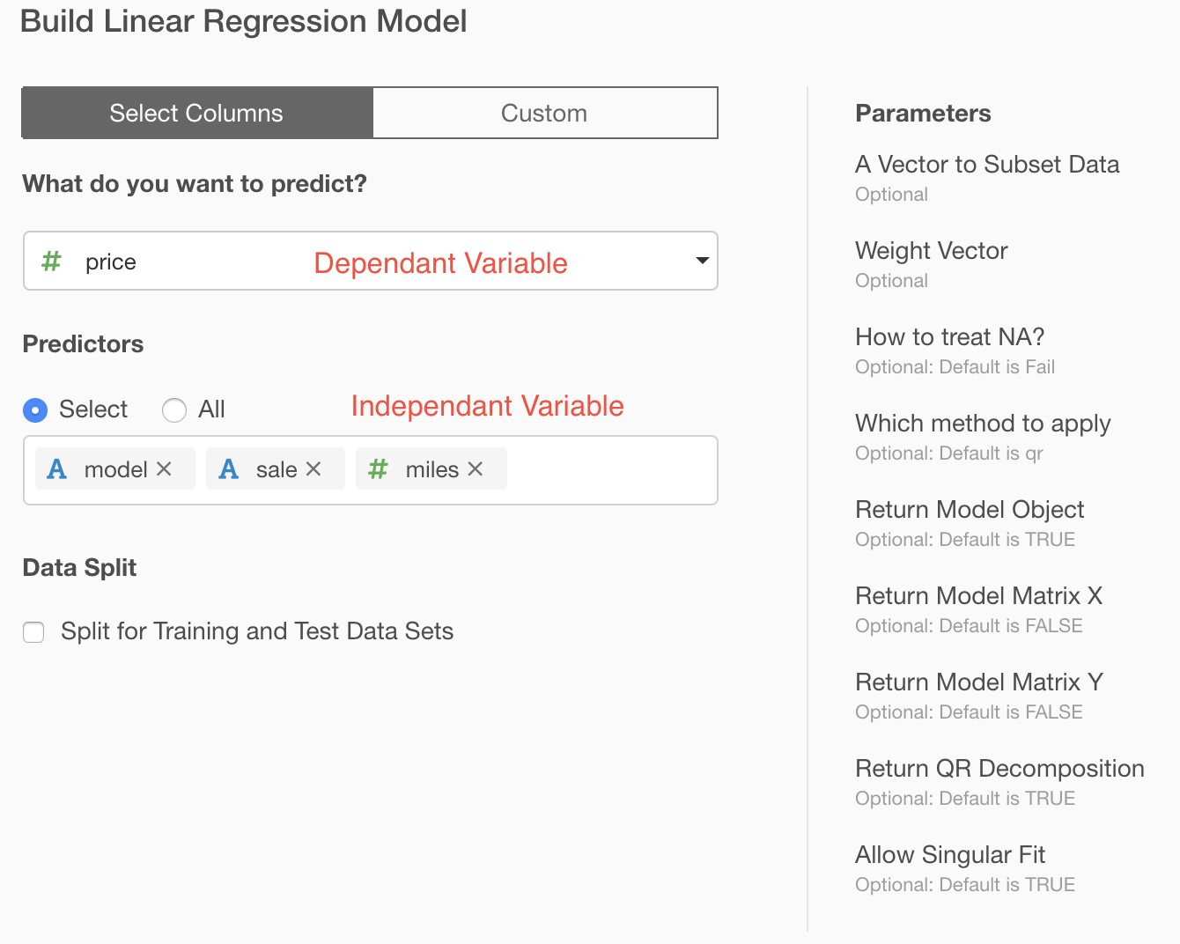
Explanatory Analytics

Slide 12
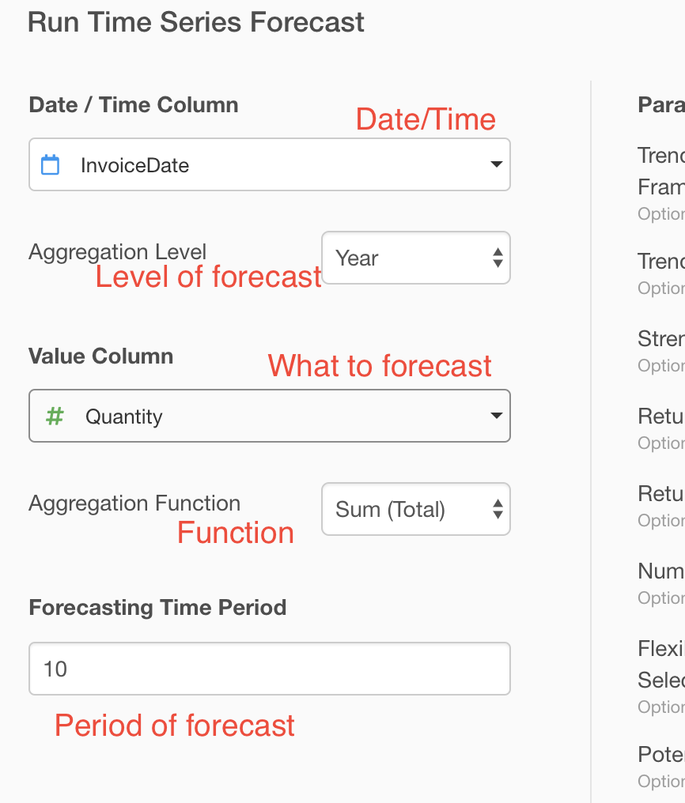
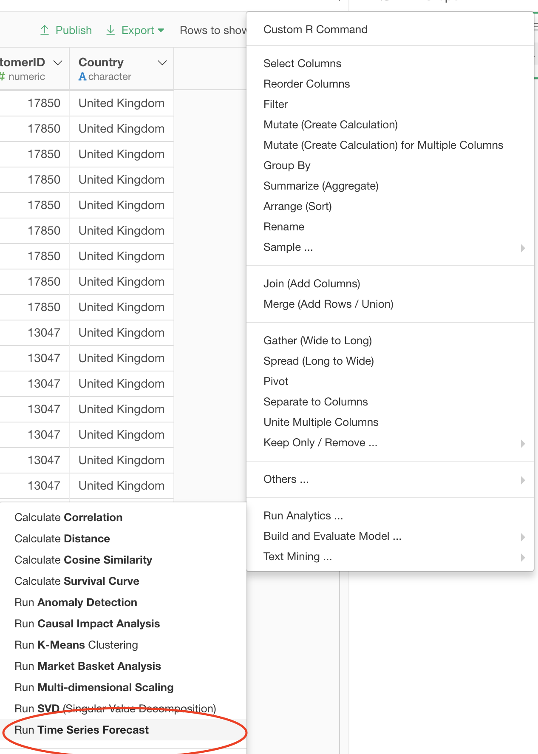
Predictive Analytics

Slide 13
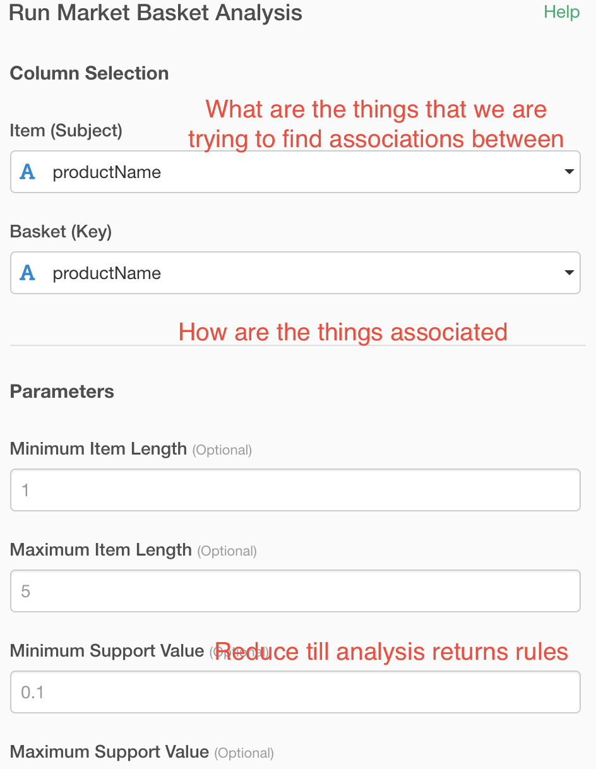
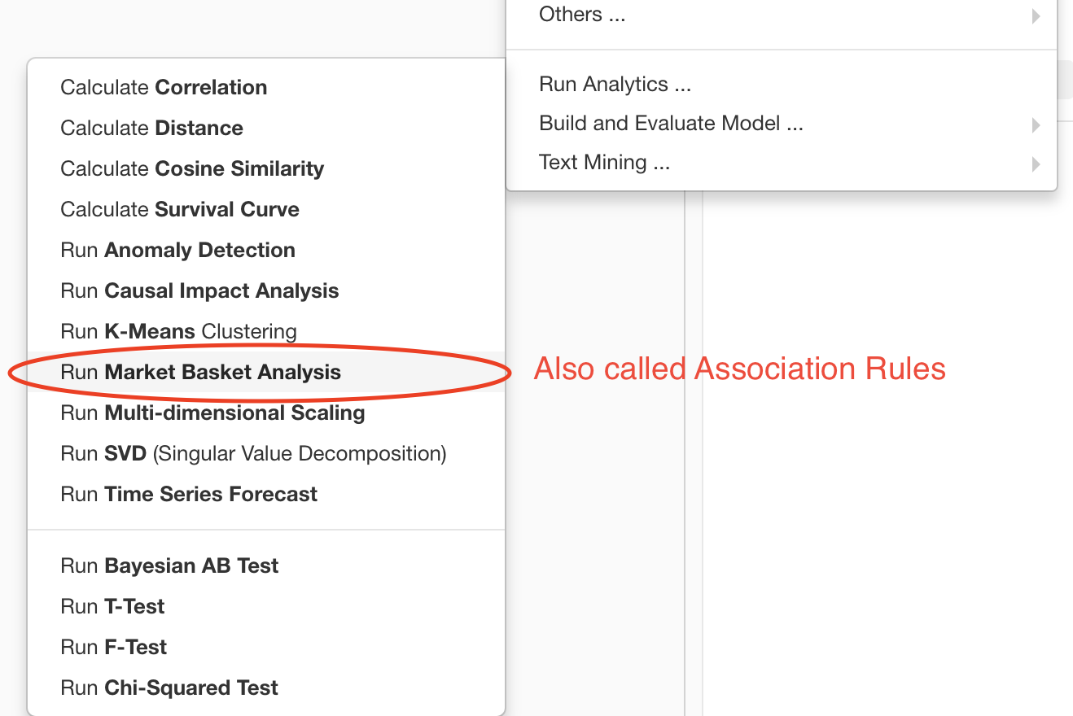
Prescriptive Analytics

